Slide 1
Chapter 2
How to design a Windows Forms application

Slide 2
Objectives (part 1)
Applied
Given the form design and property settings for a simple application, use the Form Designer to design the form.
When necessary, rename the form, project, and solution files for an application.
Customize the Visual Studio environment for use with C# by setting the Visual Studio options and the development settings.

Slide 3
Objectives (part 2)
Knowledge
Describe the use of the Toolbox and Properties windows.
Describe the Name and Text properties for a form or control.
Describe these additional properties for a control: Enabled, ReadOnly, and TextAlign.
Describe the way you adjust the tab order for the controls on a form, set access keys for controls, and set the default buttons for the Enter and Esc keys for a form.

Slide 4
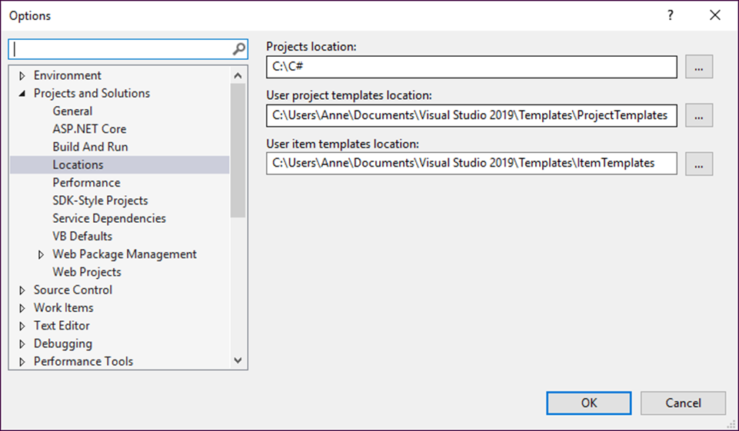
The Options dialog box for setting the project options

Slide 5
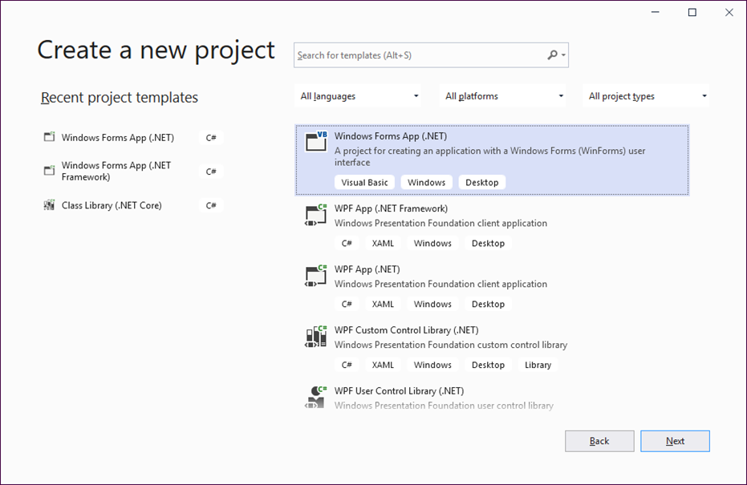
The Create a New Project window

Slide 6
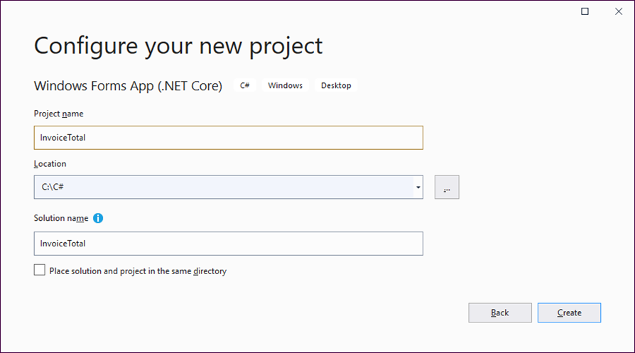
The Configure Your New Project window

Slide 7
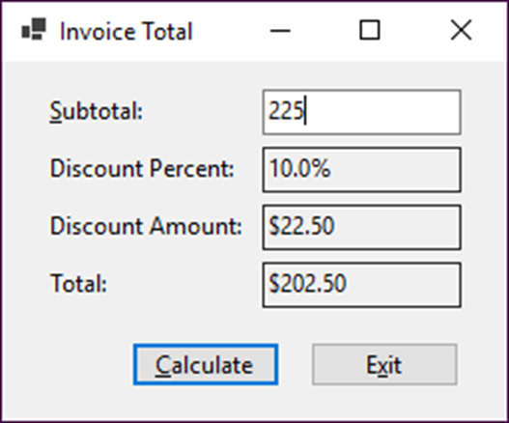
The Invoice Total form
Three types of controls
A label displays text on a form.
A text box lets the user enter text on a form.
A button initiates form processing when clicked.

Slide 8
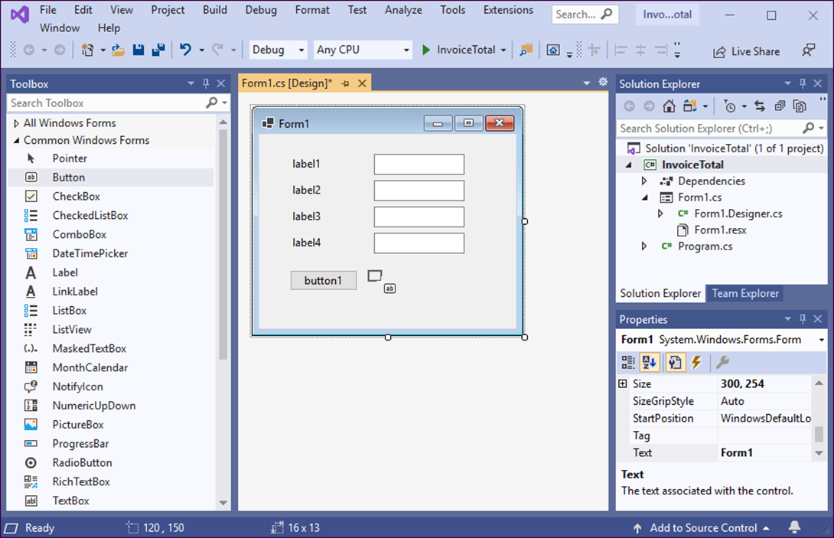
A form after some controls have been added to it

Slide 9
Three ways to add a control to a form
Select the control in the Toolbox. Then, click in the form where you want to place the control. Or, drag the pointer on the form to place the control and size it at the same time.
Double-click the control in the Toolbox. Then, the control is placed in the upper left corner of the form.
Drag the control from the Toolbox and drop it on the form. Then, the control is placed wherever you drop it.

Slide 10
How to select and work with controls (part 1)
To select a control on the form, click it.
To move a control, drag it.
To size a selected control, drag one of its handles. Note, however, that you can’t size a label by dragging its handles unless you change its AutoSize property to False.
To select more than one control, hold down the Shift or Ctrl key as you click on each control. You can also select a group of controls by clicking on a blank spot in the form and then dragging around the controls.
To align, size, or space a group of selected controls, click on a control to make it the primary control. Then, use the commands in the Format menu or the buttons on the Layout toolbar to align, size, or space the controls relative to the primary control.

Slide 11
How to select and work with controls (part 2)
You can also size all of the controls in a group by sizing the primary control in the group. And you can drag any of the selected controls to move all the controls.
To change the size of a form, click the form and drag one of its sizing handles.

Slide 12
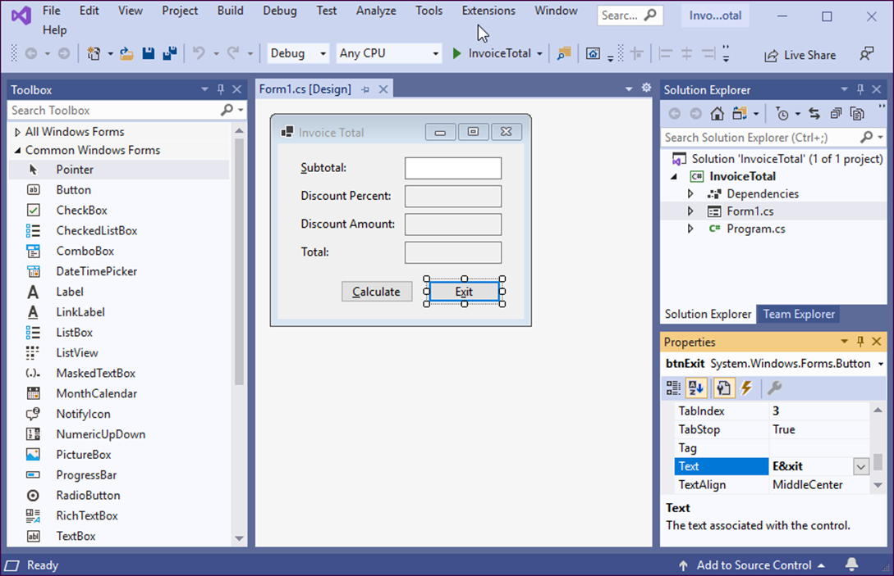
A form after the properties have been set

Slide 13
The Name property
Sets the name you use to identify a form or control in your C# code.
Can be changed to provide a more descriptive and memorable name for forms and controls that you will refer to when you write your code (such as text boxes and buttons).
Doesn’t need to be changed for controls that you won’t refer to when you write your code (such as most labels).
Can use a three-letter prefix to indicate whether the name refers to a form (frm), button (btn), label (lbl), or text box (txt).

Slide 14
The Text property
Sets the text that’s displayed on a form or control. Some controls such as forms and labels display the generic form or control name that’s generated by Visual Studio, which you’ll almost always want to change.
For a form, the Text value is displayed in the title bar. For controls, the Text value is displayed directly on the control.
For a text box, the Text value changes when the user types text into the control, and you can write code that uses the Text property to get the text that was entered by the user.

Slide 15
Other properties for forms
Property Description
AcceptButton Identifies the button that will be activated when the user presses the Enter key.
CancelButton Identifies the button that will be activated when the user presses the Esc key.
StartPosition Sets the position at which the form is displayed. To center the form, set this property to CenterScreen.

Slide 16
Other properties for controls
Property Description
Enabled Determines whether the control will be enabled or disabled.
ReadOnly Determines whether the text in some controls like text boxes can be edited.
TabIndex Indicates the control’s position in the tab order, which determines the order in which the controls will receive the focus when the user presses the Tab key.
TabStop Determines whether the control will accept the focus when the user presses the Tab key to move from one control to another. Some controls, like labels, don’t have the TabStop property.
TextAlign Sets the alignment for the text displayed on a control.

Slide 17
How to adjust the tab order
Tab order refers to the sequence in which the controls receive the focus when the user presses the Tab key. You should adjust the tab order so the Tab key moves the focus from one control to the next in a logical sequence.
Each control has a TabIndex property that indicates the control’s position in the tab order. You can change this property to change a control’s tab order position.
If you don’t want a control to receive the focus when the user presses the Tab key, change that control’s TabStop property to False.
Label controls don’t have a TabStop property so they can’t receive the focus.

Slide 18
How to set access keys
Access keys are shortcut keys that the user can use in combination with the Alt key to quickly move to individual controls on the form.
You use the Text property to set the access key for a control by placing an ampersand immediately before the letter you want to use for the access key.
Since the access keys aren’t case sensitive, &N and &n set the same access key.
When you set access keys, make sure to use a unique letter for each control.
You can’t set the access key for a text box. However, if you set an access key for a label that immediately precedes the text box in the tab order, the access key will take the user to the text box.
If you assign an access key to a button, the button is activated when you press Alt plus the access key.

Slide 19
How to set the Enter and Esc keys
The AcceptButton property of the form sets the button that will be activated if the user presses the Enter key.
The CancelButton property of the form sets the button that will be activated if the user presses the Esc key. This property should usually be set to the Exit button.
You set the AcceptButton or CancelButton values by choosing the button from a drop-down list that shows all of the buttons on the form. So be sure to create and name the buttons you want to use before you attempt to set these values.

Slide 20
The property settings for the form
Default name Property Setting
Form1 Text Invoice Total AcceptButton btnCalculate CancelButton btnExit StartPosition CenterScreen

Slide 21
The property settings for the controls (part 1)
Default name Property Setting
label1 Text &Subtotal: TextAlign MiddleLeft TabIndex 0
label2 Text Discount percent: TextAlign MiddleLeft
label3 Text Discount amount: TextAlign MiddleLeft
label4 Text Total: TextAlign MiddleLeft
textBox1 Name txtSubtotal TabIndex 1
textBox2 Name txtDiscountPercent ReadOnly True TabStop False

Slide 22
The property settings for the controls (part 2)
Default name Property Setting
textBox3 Name txtDiscountAmount ReadOnly True TabStop False
textBox4 Name txtTotal ReadOnly True TabStop False
button1 Name btnCalculate Text &Calculate TabIndex 2
button2 Name btnExit Text E&xit TabIndex 3

Slide 23
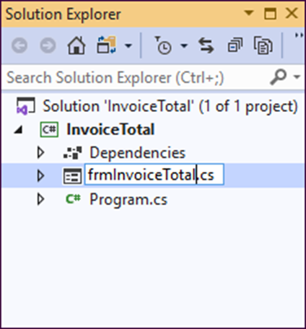
The Solution Explorer as a form file is being renamed

Slide 24
How to rename a file, project, or solution
Right-click on it in the Solution Explorer window and select the Rename command from the shortcut menu. Or, select the file, project, or solution in the Solution Explorer and press F2. Then, you can enter the new name for the file, project, or solution.
Be sure not to change or omit the file extension when you rename a file. Remember too that using a three-letter prefix to indicate the contents of the file (like frm for a form file) makes it easier to tell what each file represents.
When you change the name of a form file, Visual Studio also changes the File Name property for the form. It also asks you if you want to change all references to the file, which is usually what you want.

Slide 25
How to save a file, project, or solution
You can use the Save All button in the Standard toolbar or the Save All command in the File menu to save all files and projects in the solution.
You can use the Save button in the Standard toolbar or the Save command in the File menu to save a file, project, or solution. The files that are saved depend on what’s selected in the Solution Explorer window.
If you try to close a solution that contains modified files, a dialog box is displayed that asks you if you want to save those files.

Slide 26
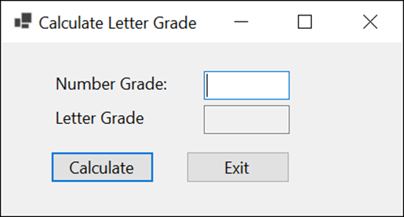
Extra 2-1 Design a simple form
Design a form that lets the user enter a number grade and then calculates the letter grade.

Slide 27
Objectives (part 1)
Applied
Given the form design and property settings for a simple application, use the Form Designer to design the form.
When necessary, rename the form, project, and solution files for an application.
Customize the Visual Studio environment for use with C# by setting the Visual Studio options and the development settings.

Slide 28
Objectives (part 2)
Knowledge
Describe the use of the Toolbox and Properties windows.
Describe the Name and Text properties for a form or control.
Describe these additional properties for a control: Enabled, ReadOnly, and TextAlign.
Describe the way you adjust the tab order for the controls on a form, set access keys for controls, and set the default buttons for the Enter and Esc keys for a form.

